Slide 1
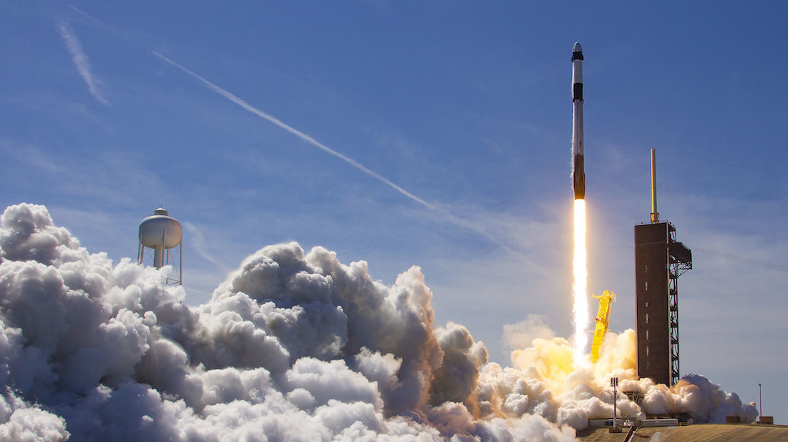

Winning the Space Race
with Data Science
Josh Moore
August 8, 2024

Slide 2

Outline
Executive Summary
Introduction
Methodology
Results
Conclusion
Appendix

Slide 3
Executive Summary
Privatized Space Exploration has led to innovation
Most notably by SpaceX
Falcon 9 reuse of the first stage of the rocket
We look at if we can predict if the first stage will land
Will lead to more accurate predictions of cost to launch
Could provide competitive advantage for alternate company, SpaceY
By using the full-stack data science process, we found we could predict if a first stage of a rocket will land with 87% accuracy
Now we can adjust budgets and provide a competitive bid against SpaceX

Slide 4
Introduction
SpaceX’s competitive advantage is its revolutionary reuse of the first stage of its rockets
First stage is essentially the base of the rocket
Rocket launches cost other companies 165 million per launch
SpaceX average 62 million a launch
Not all first stages land and are recovered, some are intentionally destroyed
Is there a way to predict if the first stage will land, if intended?
If predictable, will this knowledge provide a competitive advantage to our company, SpaceY when we bid against SpaceX?

Slide 5

Section 1

Slide 6
Methodology
Executive Summary
Data collection methodology:
API use and web scarping with BeautifulSoup
Data was in JSON format – used Python json_normalize function for conversion
Perform data wrangling
Used Python to change field names, data type, and classify binary target of whether there was a successful landing
Perform exploratory data analysis (EDA) using visualization and SQL
Perform interactive visual analytics using Folium and Plotly Dash
Perform predictive analysis using classification models
Regression, Decision Tree, SVM,

Slide 7
Data Collection
Utilized SpaceX REST API
Launch, core, capsule, starlink, launchpad, and landing pad data
Used GET request to obtain launch data in JSON format and then converted data
Leveraged BeautifulSoup package to web scrape HTML tables

Slide 8
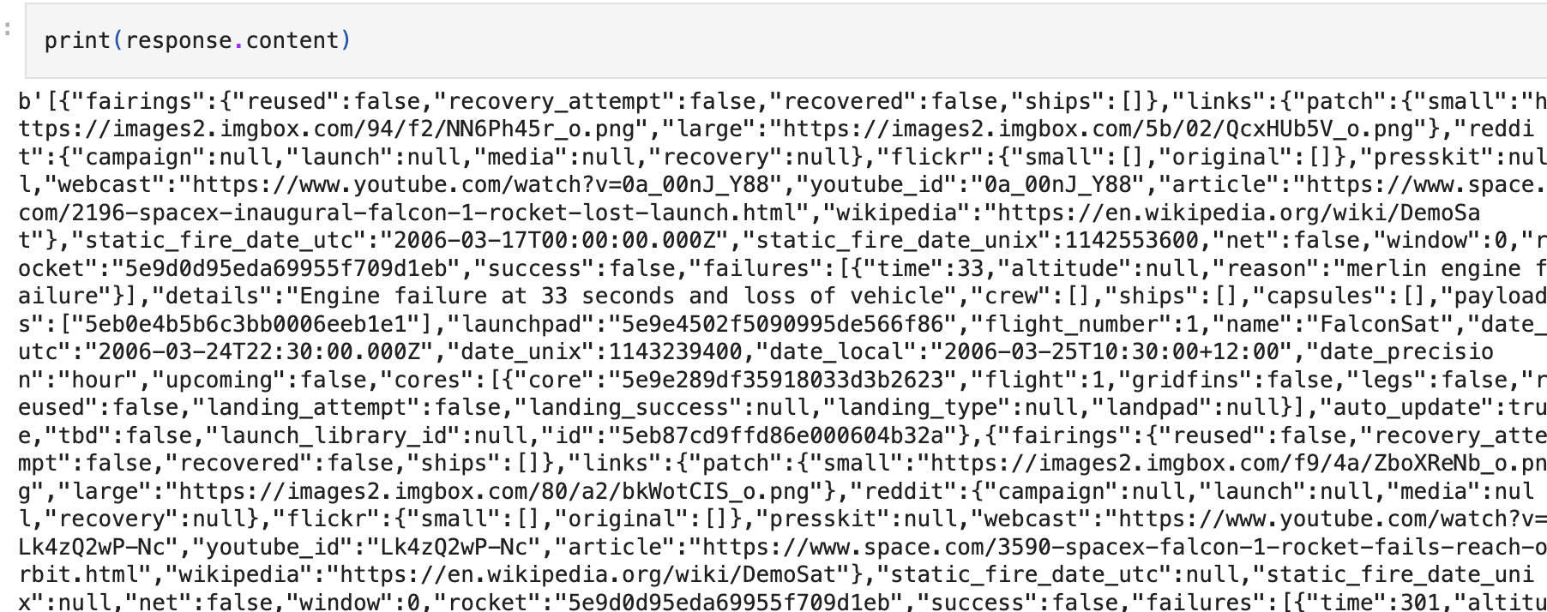
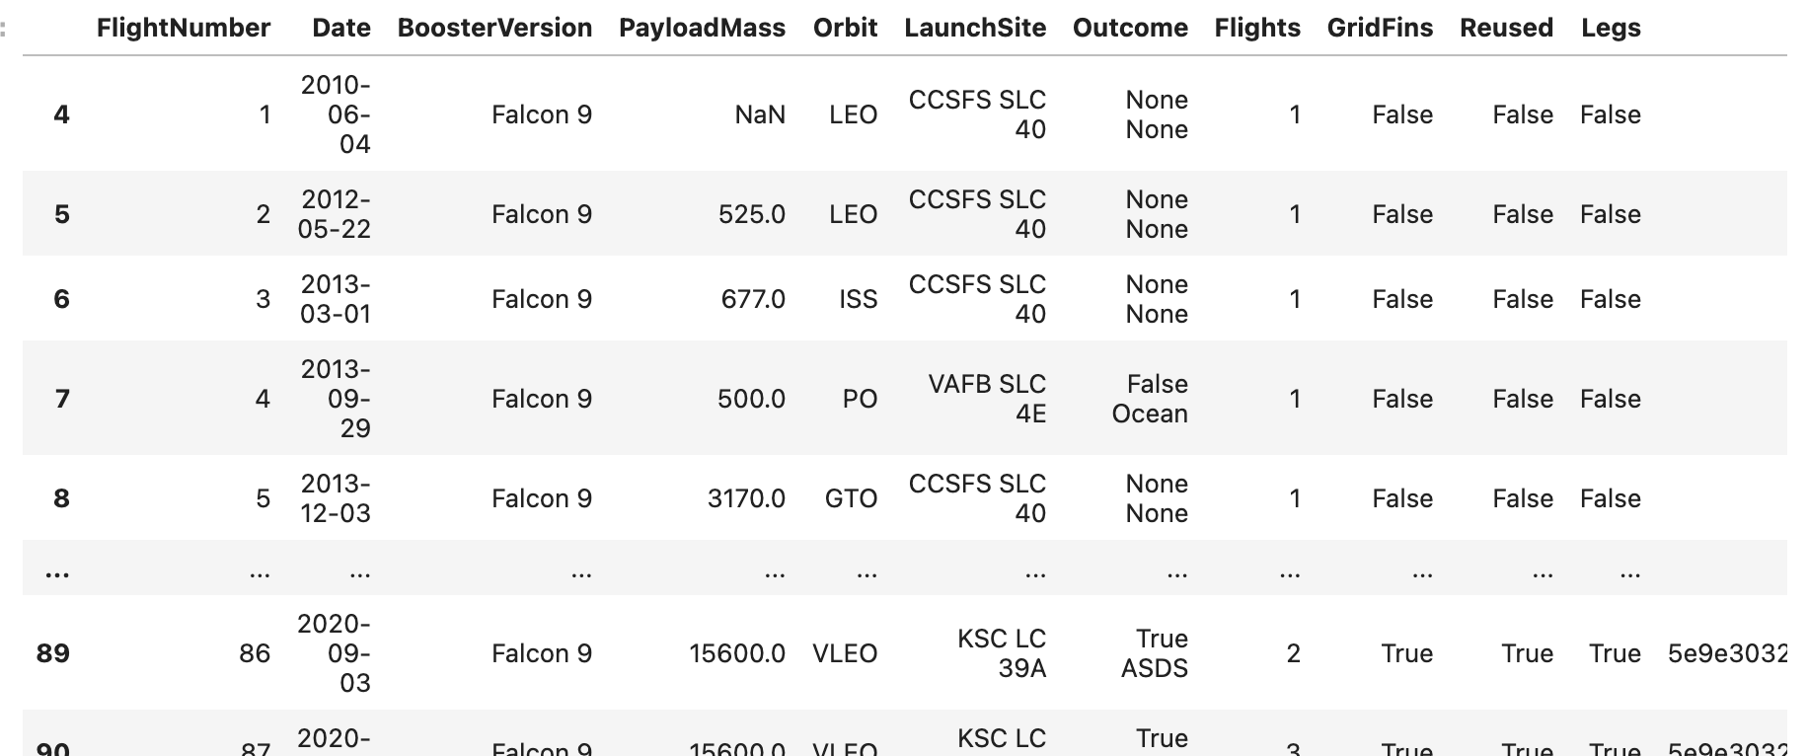
Data Collection – SpaceX API
GitHub URL of SpaceX API Calls
Response content from URL API:
Converted to dataframe:
Booster Version:
response = requests.get("https://api.spacexdata.com/v4/rockets/"+str(x)).json()
Launch Site:
response = requests.get("https://api.spacexdata.com/v4/launchpads/"+str(x)).json()
Launch Data:
response = requests.get(spacex_url)
Payload Mass:
response = requests.get("https://api.spacexdata.com/v4/payloads/"+load).json()

Slide 9
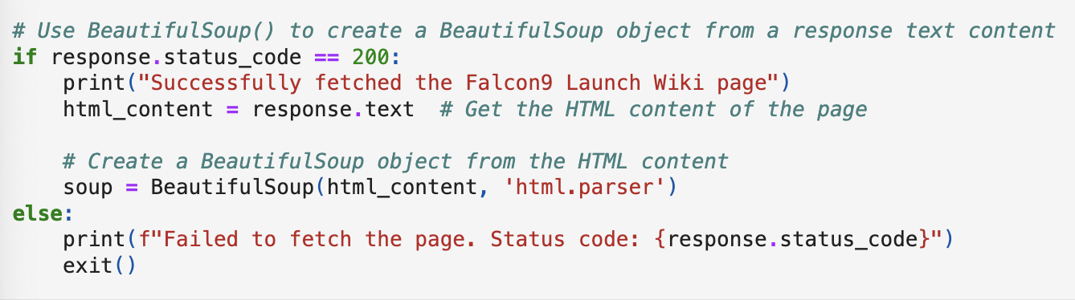
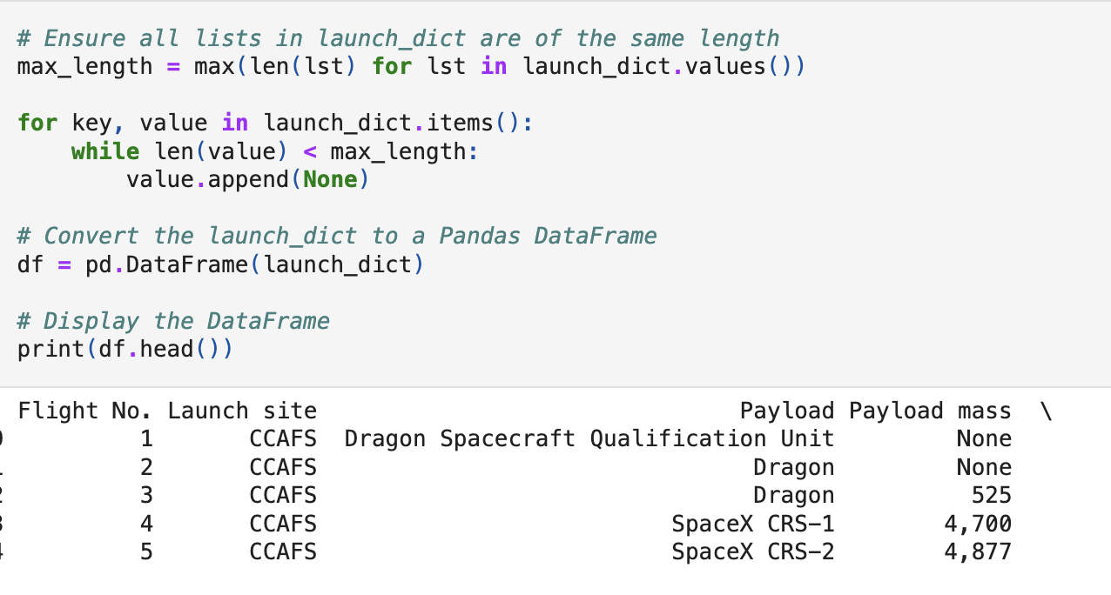
Data Collection - Scraping
Request Falcon9 Launch Wiki
Extract all column/variable names
Parsed HTML tables to create dataframe
GitHub Web Scraping SpaceX Wiki

Slide 10
Data Wrangling
Explored data, found null values, data types for fields and converted
Replaced null values with average of the field
Left null values for rockets that didn’t land
Identified different orbits for the launch and first stage outcomes
Labeled outcome column with binary classifier “Class”
0 = Unsuccessful
1 = Successful
Determined average of “Class” 67%
GitHub Data Wrangling

Slide 11
EDA with SQL
Used sqlite to query SpaceXTable
Distinct Launch Sites
Where launches began
Total payload mass transported, average payload mass transported
Date of first successful landing
Identified successful booster version that landed
Identified successful and unsuccessful mission outcomes and their different landing pads
GitHub SpaceX EDA with SQL

Slide 12
EDA with Data Visualization
Leverage Seaborn package for exploratory data analysis
Category (Scatter) plot for PayloadMass vs FlightNumber, LaunchSite vs FlightNumber, PayloadMass vs LaunchSite, FlightNumber vs Orbit, PayloadMass vs Orbit
Barplot to see success rate of each orbit type
Lineplot for target classifier, Class, vs Date of launch
Performed feature engineering and OneHotEncoder
GitHub EDA Visuals w/Python

Slide 13
Build an Interactive Map with Folium
Used Python Folium package to map NASA Johnson Space Center, and SpaceX four launch sites:
CCAFS LC-40
CCAFS SLC-40
KSC LC-39A
VARB SLC-4E
Also placed markers for each launch using red for unsuccessful and green for successful landing of first stage
GitHub Link to Folium Map Notebook

Slide 14
Build a Dashboard with Plotly Dash
Created a dynamic dashboard to include a dropdown menu, pie chart, sliding payload mass filter, and scatter plot
Easier to visualize successful landings and missions.
Easier to show different affects of payload mass and booster categories
GitHub Link to Plotly Dash Pyhton Code

Slide 15
Predictive Analysis (Classification)
Predictive analysis was done through an iterative methodical process of:
Creating each model, training the model, using pre-defined parameters to test the models and determine accuracy
Used GridSearchCV object for modeling
Used 80/20 train(72)/test (18) split sample
Models
Logistic Regression, SVM, Decision Tree and KNN
GitHub link to Predictive Analysis

Slide 16
Results
Exploratory data analysis results
Interactive analytics demo in screenshots
Predictive analysis results

Slide 17

Section 2

Slide 18
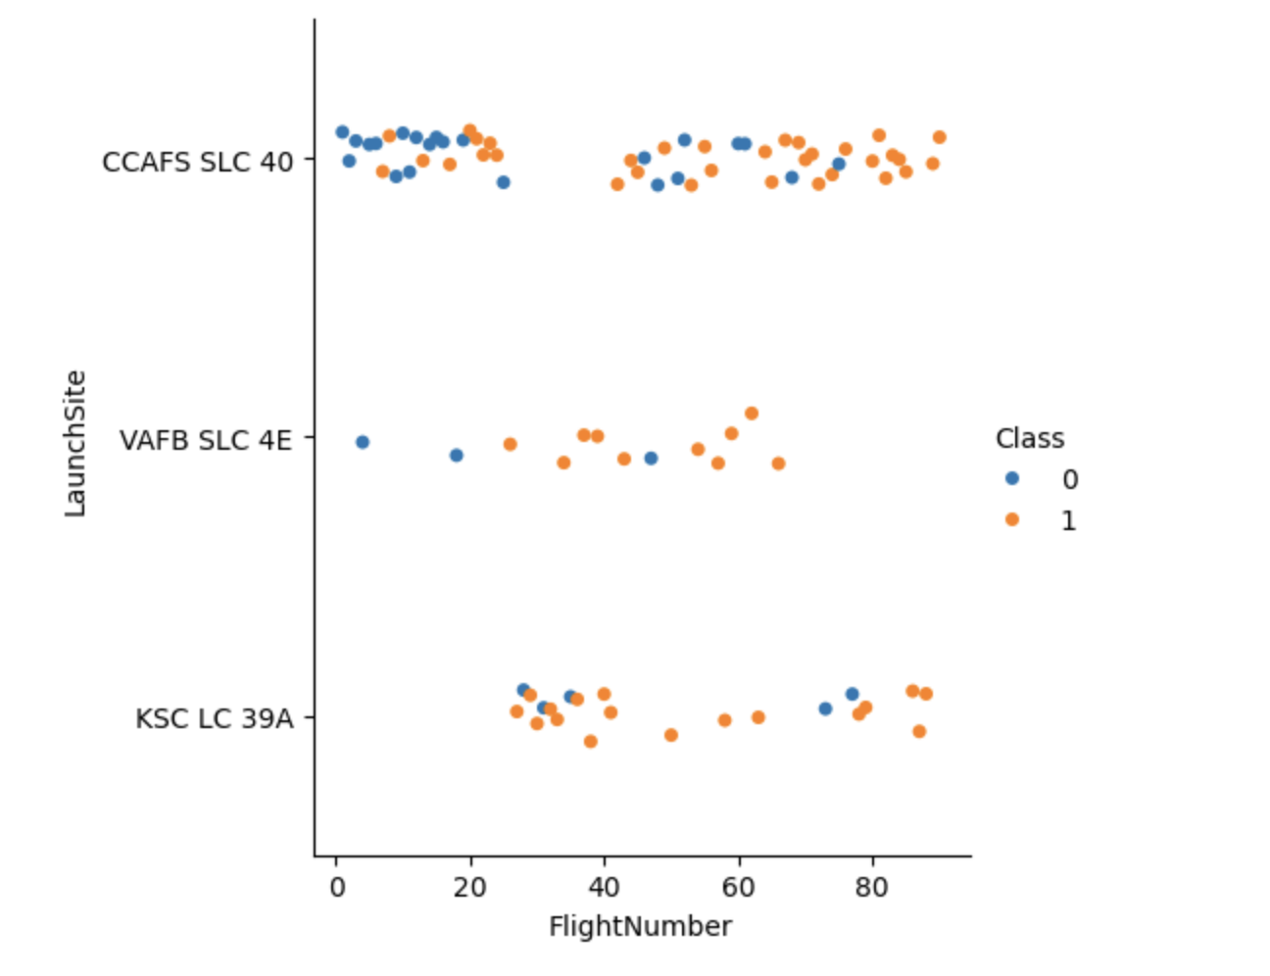
Flight Number vs. Launch Site
Orange plots represent successful landings
The more flights at a launch site, the more successful landing of the first stage booster

Slide 19
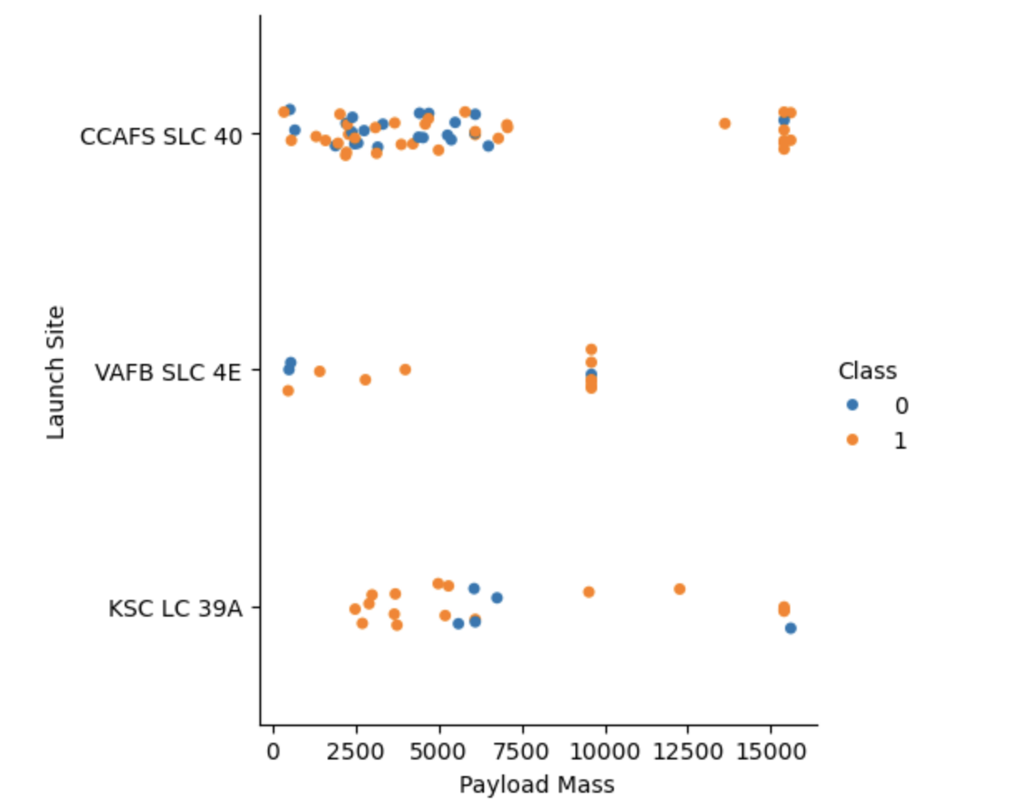
Payload vs. Launch Site
As the payload mass increased, it was more likely to have a successful landing
Some launch sites don’t have launches for payload mass greater than 10000

Slide 20
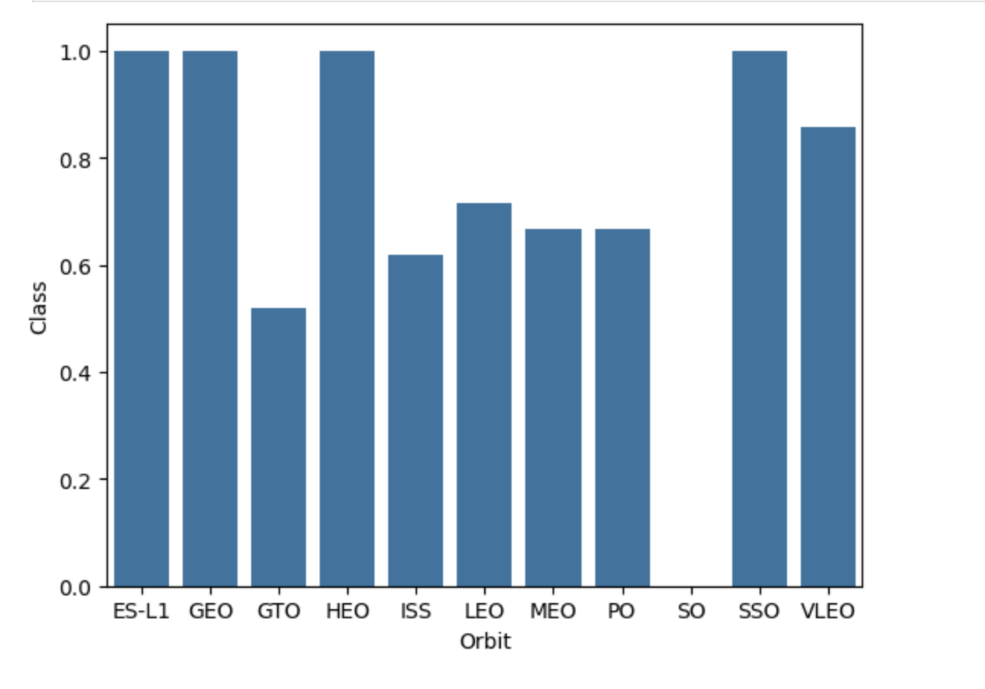
Success Rate vs. Orbit Type
Some orbits have a 100% success rate, others average, and one (SO) has no success

Slide 21
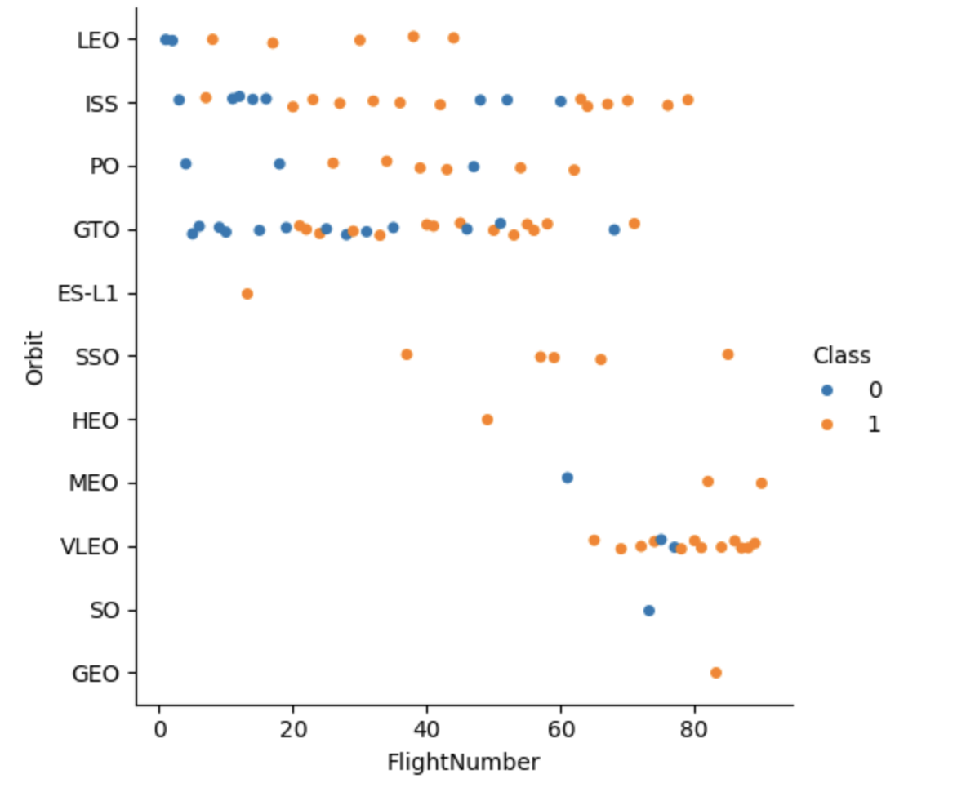
Flight Number vs. Orbit Type
Some orbits are unpredictable
Some orbits have only recently begun to be used
SpaceX is getting better at landing first stage rocket boosters

Slide 22
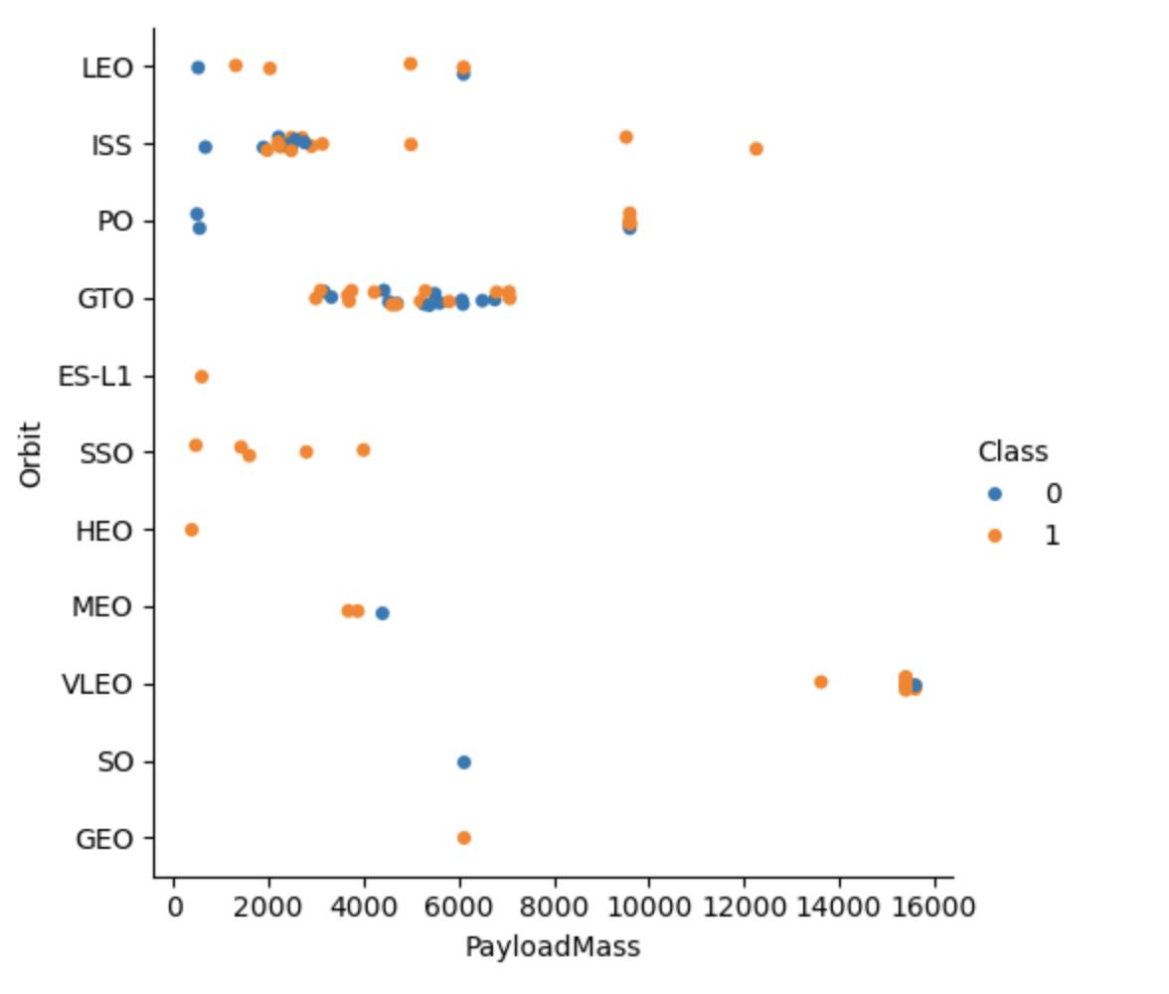
Payload vs. Orbit Type
Landing success becomes more predictable as payload mass approaches 10000
Some orbits are becoming more predictable with lower payload mass

Slide 23
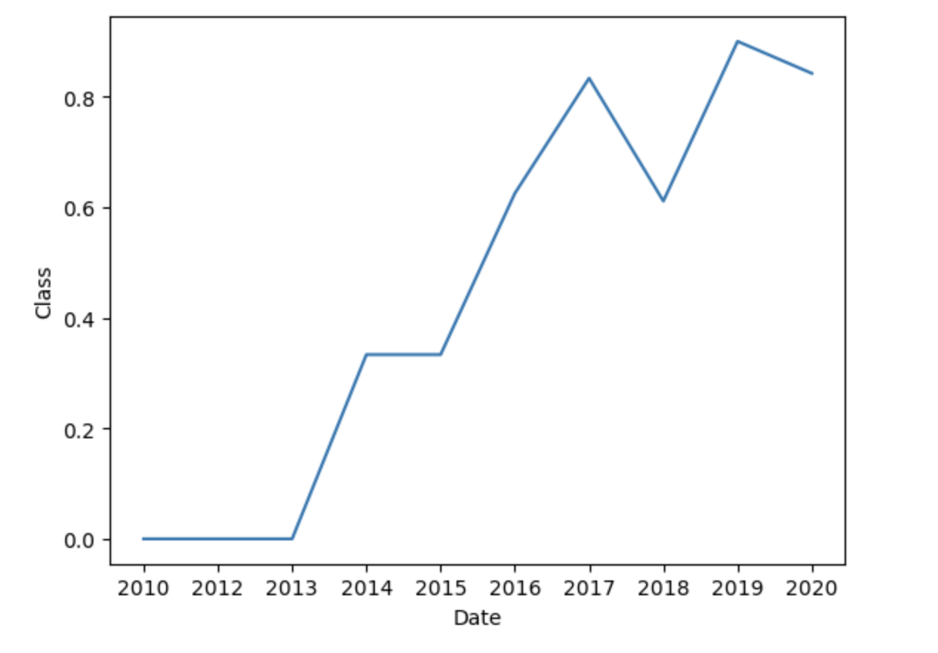
Launch Success Yearly Trend
Success rate has continued to increase since 2013

Slide 24
All Launch Site Names
All launch sites:
CCAFS LC-40
VAFB SLC-4E
KSC LC-39A
CCAFS SLC-40
%sql SELECT DISTINCT "Launch_site" FROM SPACEXTBL;
Distinct returns unique names of launch sites from SpaceX table

Slide 25
Launch Site Names Begin with 'CCA'
Find 5 records where launch sites begin with `CCA`
%sql SELECT * FROM SPACEXTBL WHERE "Launch_site" LIKE "CCA%" LIMIT 5;
All columns from SpaceX table will be returned where launch site name starts with “CCA”
Limited query to 5 records

Slide 26
Total Payload Mass
Calculate the total payload carried by boosters from NASA
%sql SELECT SUM("PAYLOAD_MASS__KG_") AS Payload FROM SPACEXTBL WHERE "Customer" LIKE "NASA (CRS)";
Total payload mass in kilograms with an alias column name – Payload
Where customer is “NASA (CRS)”

Slide 27
Average Payload Mass by F9 v1.1
Calculate the average payload mass carried by booster version F9 v1.1
%sql SELECT AVG("PAYLOAD_MASS__KG_") AS Avg_Payload FROM SPACEXTBL WHERE "Booster_Version" LIKE "F9 v1.1%";
Returns average payload mass in kilograms using an alias – Avg_Payload – from SpaceX table
Only returns records where Booster_Verusion is “F9 v1.1%”

Slide 28
First Successful Ground Landing Date
Find the dates of the first successful landing outcome on ground pad
%sql SELECT MIN("Date") FROM SPACEXTBL WHERE "Mission_Outcome" = "Success";
Query provides the minimum, or earliest, date where SpaceX had a successful Mission_Outcome

Slide 29
Successful Drone Ship Landing with Payload between 4000 and 6000
List the names of boosters which have successfully landed on drone ship and had payload mass greater than 4000 but less than 6000
%sql SELECT DISTINCT "Booster_Version" FROM SPACEXTBL WHERE "Landing_Outcome" = "Success (drone ship)" AND ("PAYLOAD_MASS__KG_" > 4000 AND "PAYLOAD_MASS__KG_" < 6000);
Unique booster versions where landing outcome was a success on a drone ship while the payload was between 4000 and 6000 kg.

Slide 30
Total Number of Successful and Failure Mission Outcomes
Calculate the total number %sql SELECT "Mission_Outcome", COUNT("Mission_Outcome") FROM SPACEXTBL GROUP BY "Mission_Outcome";
Query returns the number of records grouped by success, failure (in flight), and success (payload status unclear).
There were 100 successful mission outcomes and one failure
of successful and failure mission outcomes

Slide 31
Boosters Carried Maximum Payload
List the names of the booster which have carried the maximum payload mass
%sql SELECT DISTINCT "Booster_Version" FROM SPACEXTBL WHERE "PAYLOAD_MASS__KG_" = (SELECT MAX("PAYLOAD_MASS__KG_") FROM SPACEXTBL);
This query provides a unique list of booster versions that carried the maximum payload mass in kg
There were 12 different booster in total

Slide 32
2015 Launch Records
List the failed landing_outcomes in drone ship, their booster versions, and launch site names for in year 2015
%sql SELECT substr(DATE,6,2), "Landing_Outcome", "Booster_Version", "Launch_Site" FROM SPACEXTBL WHERE substr(Date,0,5)='2015' AND "Landing_Outcome"="Failure (drone ship)";
This query lists the records where the landing outcome was a failure
The lists will include the month, booster version, landing outcome, and launch site.
Query insured only launches from 2015 and the failures occurred while trying to land on a drone ship

Slide 33
Rank Landing Outcomes Between 2010-06-04 and 2017-03-20
Rank the count of landing outcomes (such as Failure (drone ship) or Success (ground pad)) between the date 2010-06-04 and 2017-03-20, in descending order
%sql SELECT "Landing_Outcome", COUNT("Landing_Outcome") FROM SPACEXTBL WHERE Date BETWEEN "2010-06-04" AND "2017-03-20" GROUP BY "Landing_Outcome" ORDER BY COUNT("Landing_Outcome") DESC;
This query ranks the different categories of landing outcomes and how many of each kind occurred.
“No attempt” led the list with 10 occurrences, while ”Precluded (drone ship)” only had 1 occurrence

Slide 34

Section 3

Slide 35
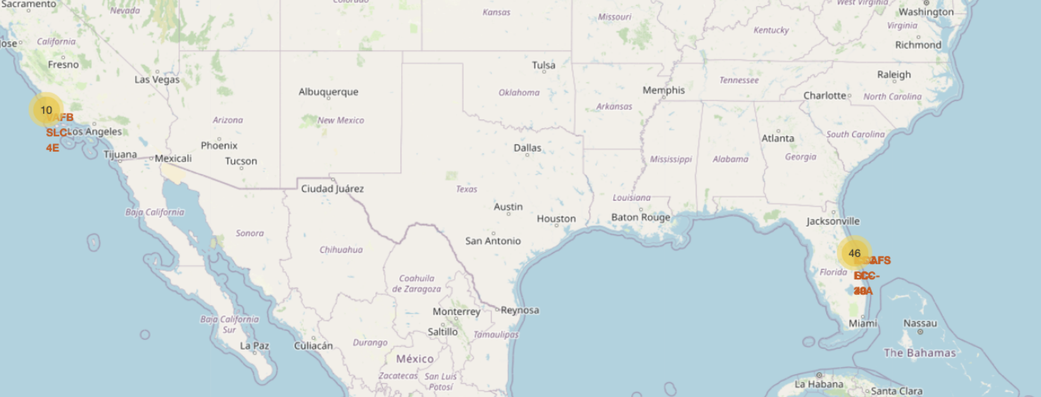
As seen on the Folium map, there are two different clusters of launch sites – one on the east and one on the west coast
East coast is where 46 launches occurred while 10 launches occurred on the west coast.
SpaceX Launch Sites

Slide 36
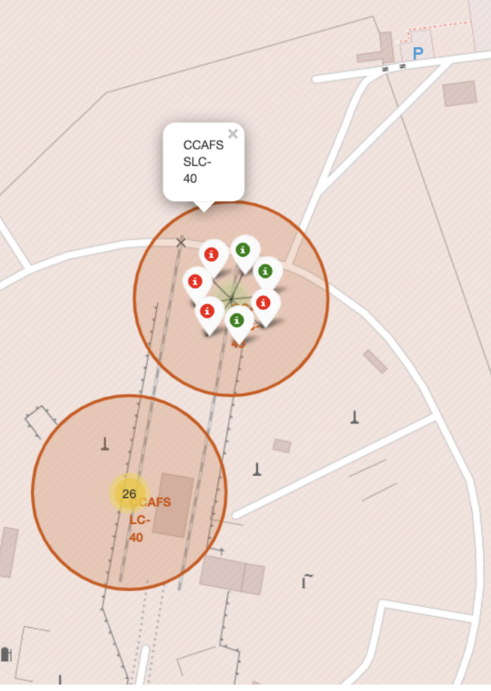
CCAFS SLC-40 Launch Site Example
As seen on the Folium screenshot, launches are depicted as successful (green) or unsuccessful (red)

Slide 37

Section 4

Slide 38
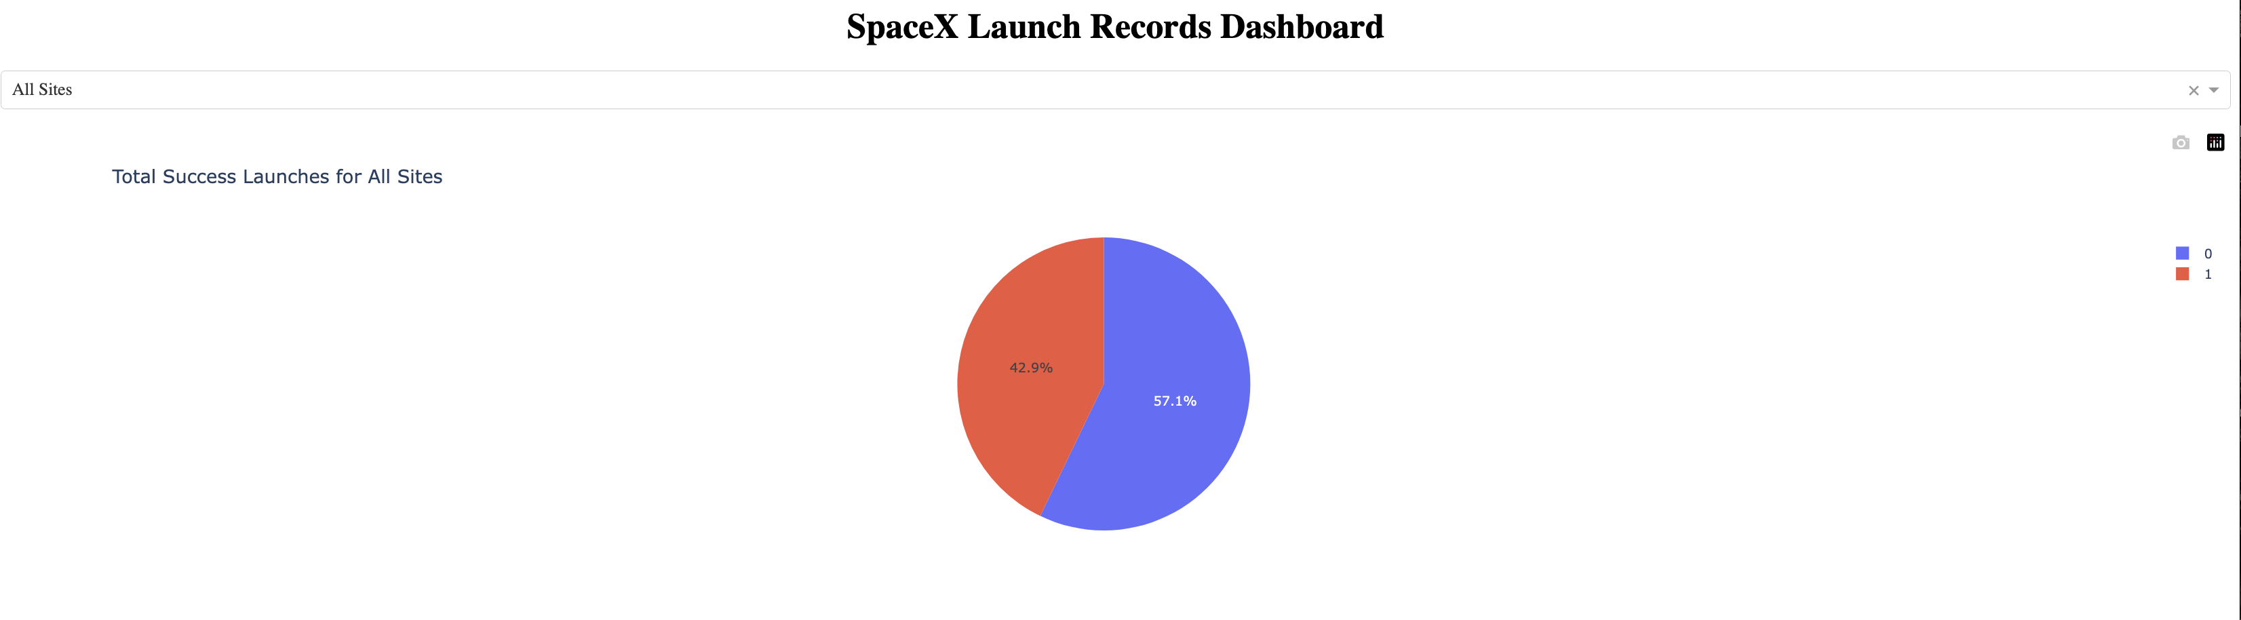
Dashboard Showing Launch Successes
The dropdown menu has “All Sites” selected and the pie chart shows 42.9% success and 57.1% failure

Slide 39
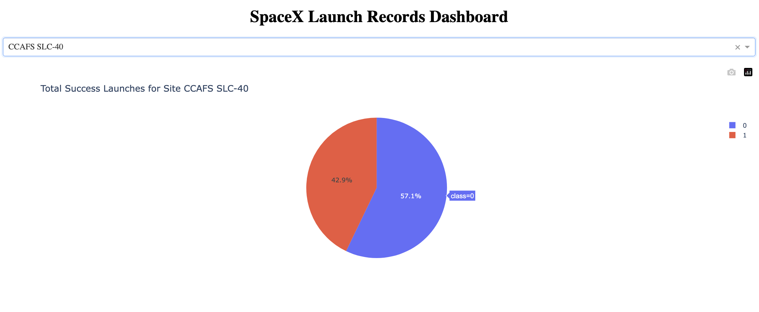
<Dashboard Screenshot 2>
Most successful launch site – CCAFS SLC-40

Slide 40
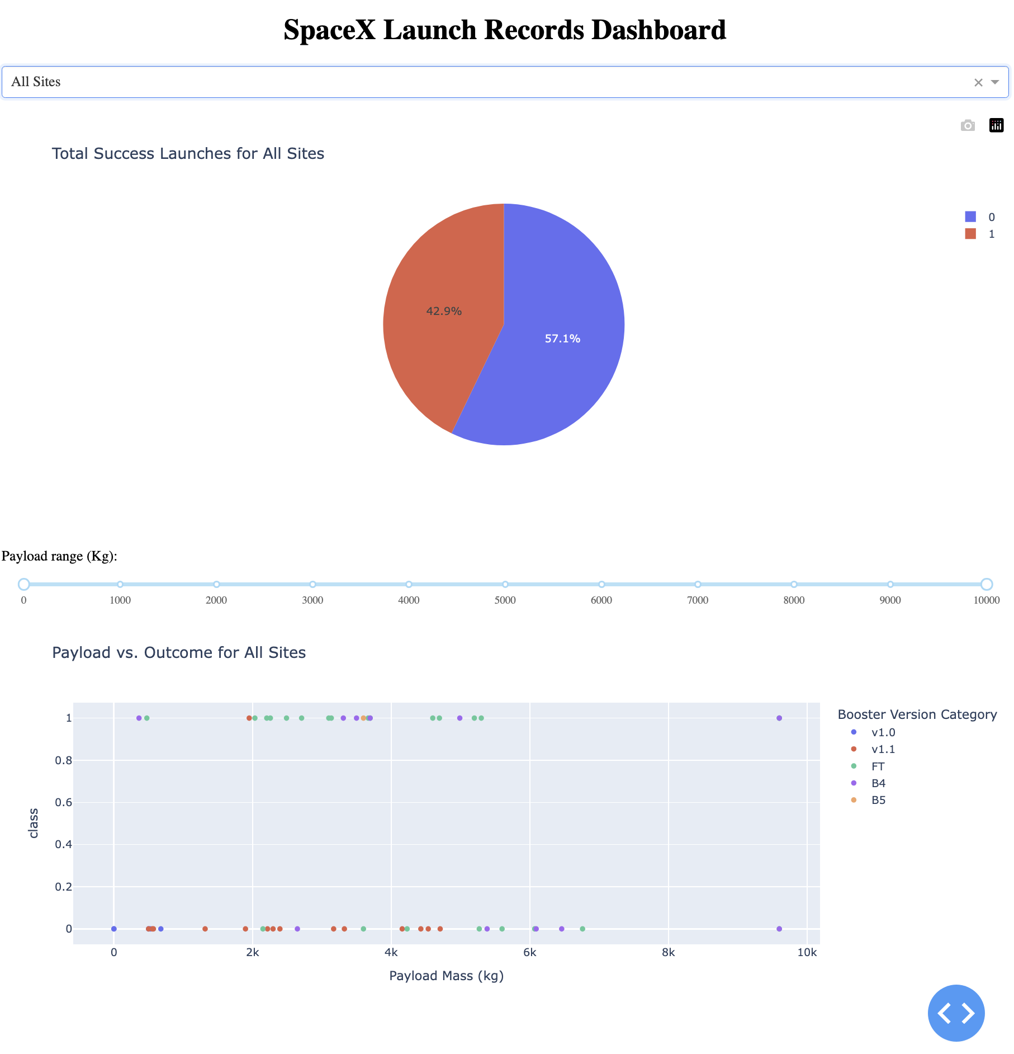
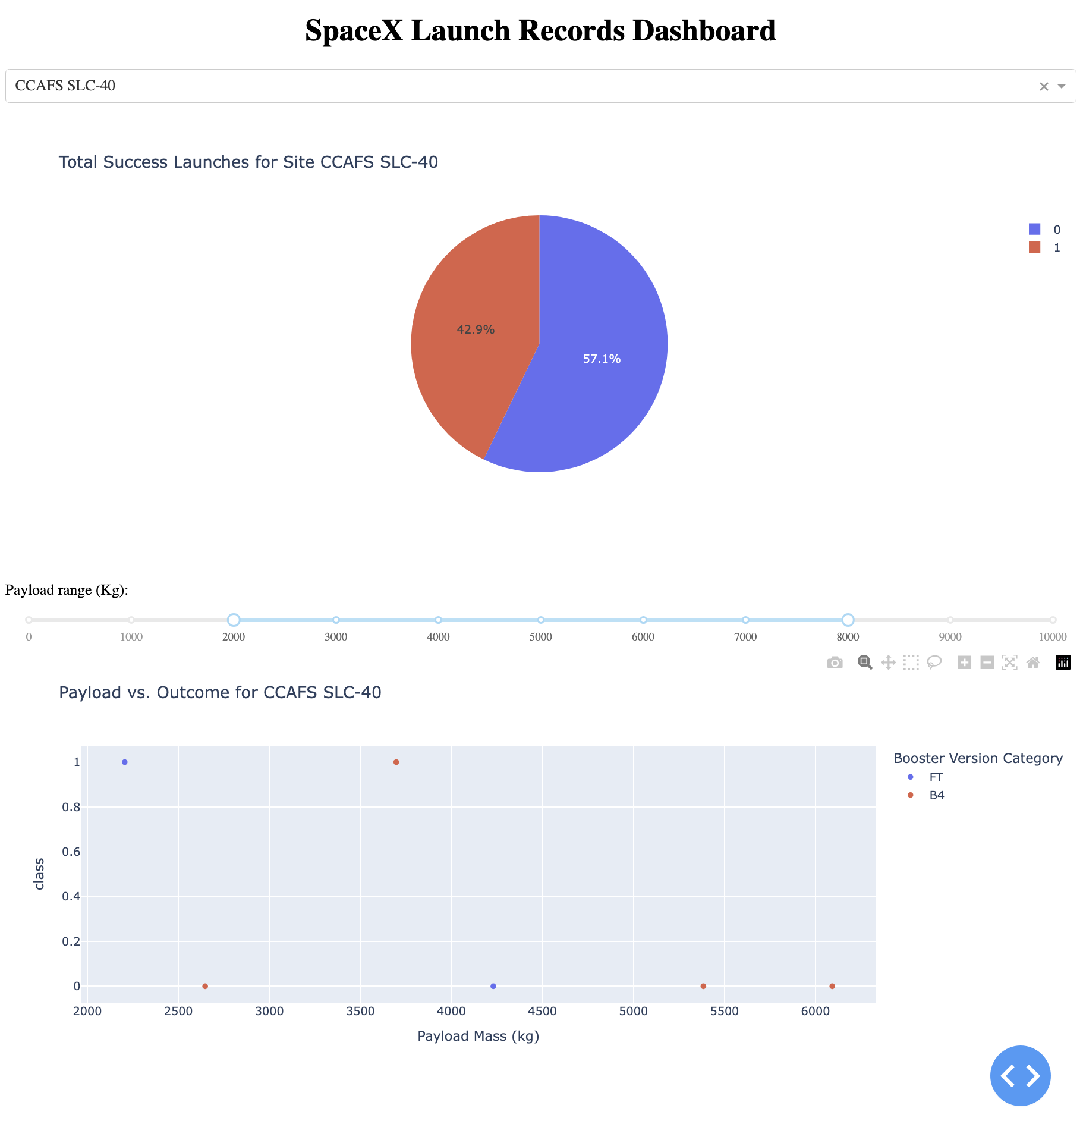
Dynamic Dashboard
These screenshots show the dynamic ability of the dropdown menu
Also displays the difference when the Payload range is changed

Slide 41

Section 5

Slide 42
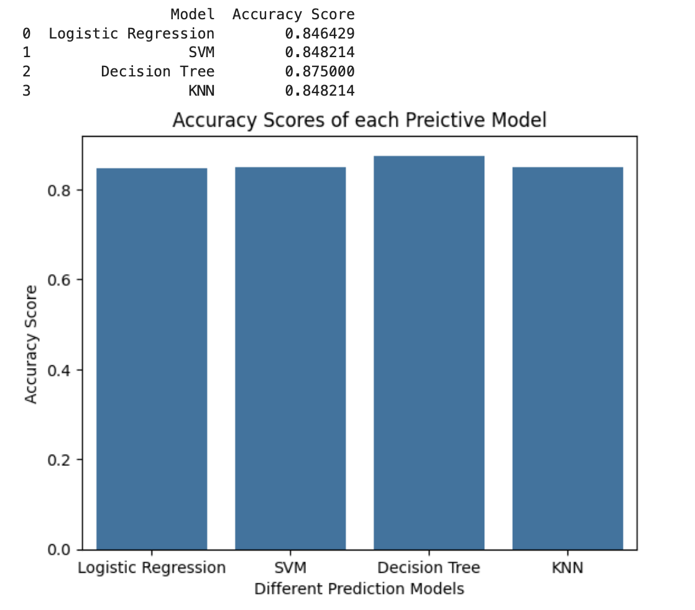
Classification Accuracy
We found that the Decision Tree predicative model has the highest accuracy at 87.5%

Slide 43
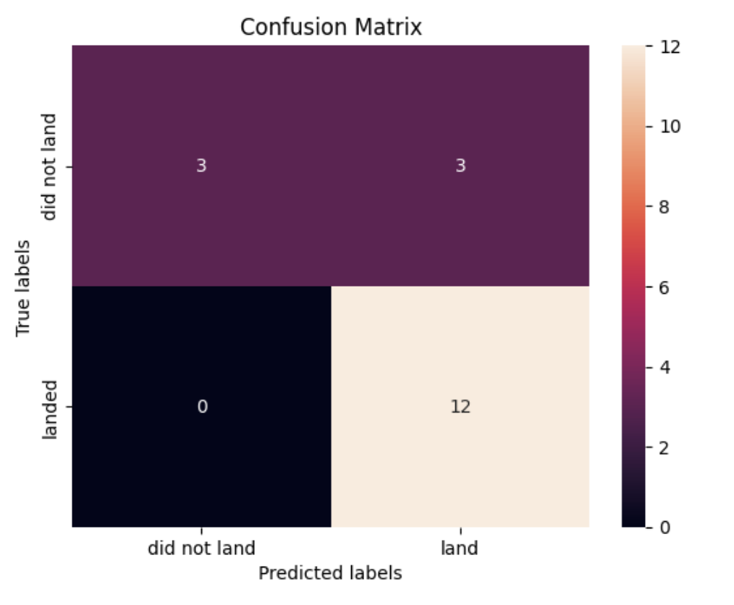
Confusion Matrix
Our model was excellent at predicting if a booster would actually land
There was some error on predicting when a booster would not land with a false positive rate of 50%.

Slide 44
Conclusions
Through carefully utilizing the predictive analysis methodology, we conclude:
We can predict when a first stage booster will land successfully by an accuracy rate of 87%
We know that certain payload mass and flight number combinations provide optimal results
We also know that some launch sites have better landing success rates.
We also found that certain landing pads where more likely to result in a successful landing
We saw how success is trending upward and
Orbits ES-L1, GEO, HEO, SSO resulted in the greatest success rate for landing the boosters
These insights will help our company, SpaceY accurately bid against SpaceX and feel confident in our estimations

Slide 45


